Slide 1
Recitation 1
Select-From-Where Statements
Multirelation Queries

Slide 2
Get Access to the BarBeerDrinker database on AWS
Setting up MySQL workbench
Downloads are available at http://dev.mysql.com/downloads/workbench/.
Manual: https://dev.mysql.com/doc/workbench/en/wb-installing.html .
Tutorial: Setting up MySQL workbench and Connecting to AWS db instance.docx
Connecting to the db instance on AWS
Hostname: tomaszdb.cjcp84c7rqes.us-east-2.rds.amazonaws.com
Port: 3306
Account:
username: student
Pwd: databasestudent

Slide 3
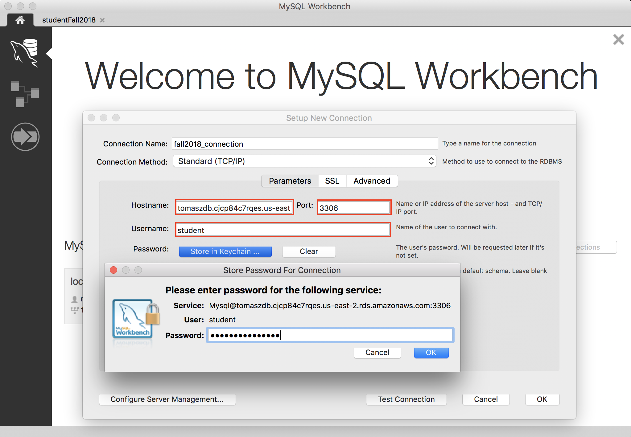

Slide 4
Bars that sell the beer Budweiser at $5.5.
SELECT bar
FROM sells
WHERE beer = 'Budweiser‘
AND price = 5.5
bar
Caravan
The Blank Club

Slide 5
Beers served for exactly $5 at either Cabana or The B-Hive, or both.
SELECT beer
FROM sells
WHERE price = 5
AND (bar = 'Cabana' or bar = 'The B-Hive')
beer
Budweiser
Michelob Amber Bock
C
B

Slide 6
Beers served for exactly $5 at either Cabana or The B-Hive, or both.
(SELECT beer FROM sells WHERE price = 5 AND bar = 'Cabana')
UNION
(SELECT beer FROM sells WHERE price = 5 AND bar = 'The B-Hive')
C
B

Slide 7
Bars that serve Budweiser or Original Premium Lager Dog, but not both.
(SELECT bar FROM sells WHERE beer = 'Budweiser')
UNION
(SELECT bar FROM sells WHERE beer= 'Original Premium Lager Dog')
MINUS
Bud
OPLD
(SELECT s1.bar FROM sells s1, sells s2
WHERE s1.bar = s2.bar
AND s1.beer = 'Budweiser'
AND s2.beer = 'Original Premium Lager Dog')
Notes:
– Union + Minus, + self-join. + intersect to rewrite it. + or to rewrite it.

Slide 8
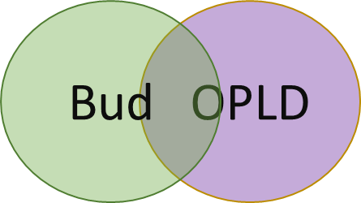
Bars that serve Budweiser or Original Premium Lager Dog, but not both.
(SELECT bar FROM sells WHERE beer = 'Budweiser')
UNION
(SELECT bar FROM sells WHERE beer= 'Original Premium Lager Dog')
MINUS
INTERSECT
((SELECT bar FROM sells WHERE beer = 'Budweiser')
(SELECT bar FROM sells WHERE beer= 'Original Premium Lager Dog'))

Slide 9
A beer that is sold in at least two bars. Provide bar names. Order those beers by average price in the two bars most to least.
SELECT s1.beer, s2.bar, s1.bar,
(s1.price + s2.price)/2 as avg_price
FROM sells s1, sells s2
WHERE s1.beer = s2.beer
AND s1.bar <> s2.bar
ORDER BY avg_price DESC
AND s1.bar > s2.bar

Slide 10
Bars that serve a beer from both manufacturer X and manufacturer Y.
SELECT s.bar FROM sells s, beers b WHERE s.beer = b.name AND b.manf = X
INTERSECT
SELECT s.bar FROM sells s, beers b WHERE s.beer = b.name AND b.manf = Y
Bar | beer | beer manf
Fog | White | Allagash
Fog | Fin Du Monde | Unibroue
X = Allagash
Y= Unibroue
Bar
Fog
Notes:
– Union + Minus, + self-join. + intersect to rewrite it. + or to rewrite it.

Slide 11
Find the bars which sell at least one beer liked by two different drinkers.
SELECT sells.bar
FROM likes l1, likes l2, sells
WHERE l1.drinker <> l2.drinker
AND l1.beer = sells.beer
AND l2.beer = sells.beer
Notes:
– Union + Minus, + self-join. + intersect to rewrite it. + or to rewrite it.

Slide 12
Find the bars which sell at least one beer liked by two different drinkers.
SELECT DISTINCT sells.bar
FROM likes l1, likes l2, sells
WHERE l1.drinker <> l2.drinker
AND l1.beer = sells.beer
AND l2.beer = sells.beer
Notes:
– Union + Minus, + self-join. + intersect to rewrite it. + or to rewrite it.

Slide 13
Select all beers with maximum price.
SELECT beer FROM sells WHERE price >=
ALL (SELECT price FROM sells)
1
2
3
3
SELECT beer FROM sells WHERE price >=
ANY (SELECT price FROM sells)
1
2
3
SELECT beer FROM sells WHERE price >
ANY (SELECT price FROM sells)
2
3
Select all beers except the cheapest.
Notes:
ALL means greater than every value, means greater than the maximum value. Suppose ALL (1, 2, 3) means greater than 3.
> ANY means greater than at least one value==greater than the minimum

Slide 14
Assume beer name contains manufacturer name. Find all beers produced by Allagash.
Name
Allagash White
River Horse Hop-a-lot-amus
White Allagash
SELECT name FROM beer WHERE name LIKE ‘%Allagash%’
Allagash White
White Allagash
SELECT name FROM beer WHERE name LIKE ‘Allagash%’
Allagash White

